Slide 1
Types of Radiation

Slide 2
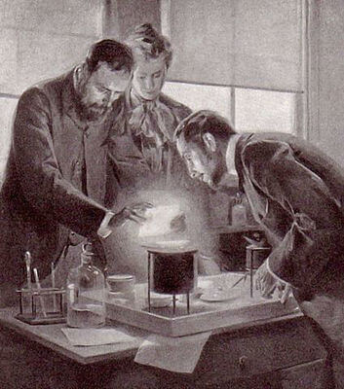
In this Smart Lesson you will learn to:
Explain natural radioactive decay in terms of stability.
Define alpha radiation, beta positive radiation, beta negative radiation and gamma radiation.
Describe alpha, beta positive, beta negative and gamma radiation, including the properties of penetrating ability, charge, mass and ionisation ability.

Slide 3
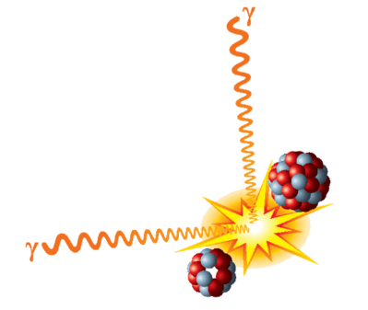
Radioactive decay.
Atoms in nature are either stable or unstable. This is determined by the nuclear forces. If the forces are balanced, the atom is stable. If the forces are unbalanced, such as due to a different ratio of protons to neutrons, the nucleus will have an excess of energy. It will spontaneously give out particles or energy to become stable.
Natural radioactive decay is the process by which the nucleus of an unstable atom loses energy by emitting radiation, including alpha particles, beta particles, gamma rays and electrons without artificial stimulus to do so.

Slide 4
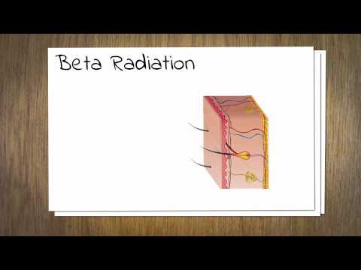

Slide 5
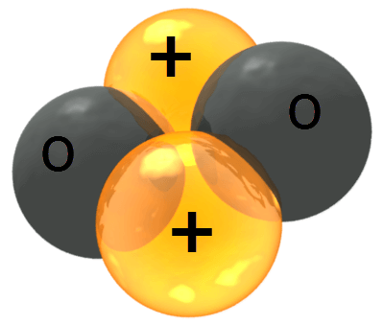
Alpha radiation is basically the emission of a helium nucleus.
This is because alpha particles are made up of two protons and two neutrons.
Alpha particles are large, positively charged and slow moving. They have the symbol α.
They have a range of a few centimetres in air and have a very low penetrating power. Alpha particles can not pass through paper or skin.

Slide 6
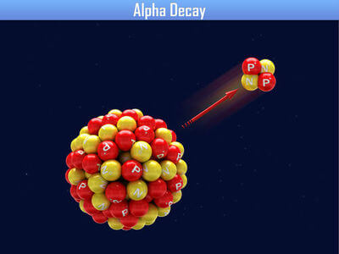
Alpha particles were discovered by New Zealand scientist, Ernest Rutherford, in 1909.
Alpha decay tends to occur in the heavier elements such as Uranium, Polonium and Thorium.
It occurs when the ratio of neutrons to protons in the nucleus is low.
Alpha particles are highly ionising because of their double positive charge, large mass and because they are relatively slow. As they can only penetrate a short distance, they are generally not dangerous to biological tissue unless they are inside the body, such as through ingestion or inhalation.

Slide 7


There are two types of beta radiation:
electron emission (or β− decay) and positron emission (or β+ decay).
Both of these particles have a range of a few metres and moderate penetrating power. Beta particles can be blocked by a few millimetres of aluminium.
Electron emission is the emission of a negatively charged electron. This is modelled by a neutron changing into a proton and an electron.
Positron emission is the emission of a positively charged electron. This is modelled by a proton changing into a neutron and an electron.

Slide 8
Henri Becquerel, the French physicist, first discovered beta radiation.
Beta negative radiation occurs when the ratio of neutrons to protons in the nucleus is too high. An excess neutron transforms into a proton and an electron, then the electron is released.
Beta positive radiation occurs when the ratio of neutrons to protons in the nucleus is too low. An excess proton transforms into a neutron and a positron, then the positron is released. A positron has the same mass as an electron, but the opposite charge.
Beta particles are less ionising than alpha particles, having a single charge. They can travel a few metres through air or millimetres into living tissue, and exposure can cause burns to the skin. If beta emitting radionuclides are ingested or inhaled, they can damage internal organs.

Slide 9
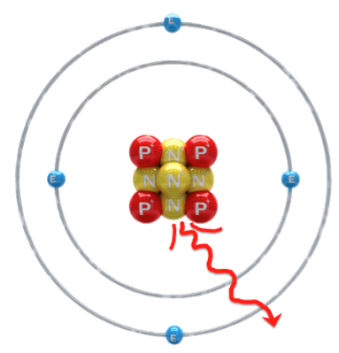
Gamma radiation is a form of very high frequency electromagnetic radiation.
Gamma rays are highly penetrating. They can be blocked by 30cm of steel, but their intensity can be halved by 1cm of lead.
There is no maximum range of gamma rays in air. This is because they are so energetic that they are not absorbed by air.

Slide 10
The French physicist, Paul Villard, discovered gamma radiation.
Gamma rays are a form of electromagnetic radiation. They can be described as photons (massless particles) which travel as waves at the speed of light.
They are less ionising than alpha or beta radiation, but can penetrate much greater distances, requiring materials such as lead to stop them.
Gamma emitters have many uses, including measuring flow of liquids in industry, sterilisation of medical equipment, measurement of thickness of materials and pasteurising some foods.

Slide 11
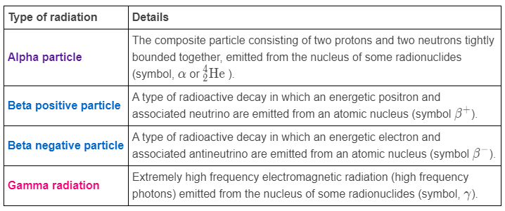
Summary of radiation types.

Slide 12
The effect of electric and magnetic fields on radiation.
Alpha, beta and gamma radiation all behave differently in electric and magnetic fields.

Slide 13
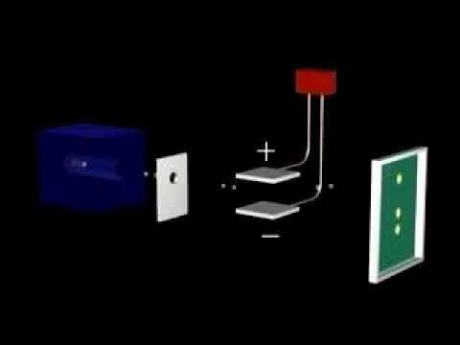

Slide 14
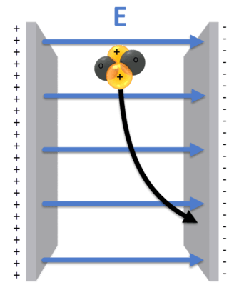
Alpha radiation is deflected in the same direction as the direction of the electric field.
Electric fields always go from the positive plate to the negative plate. Therefore, alpha particles move towards the negative plate in this system.

Slide 15
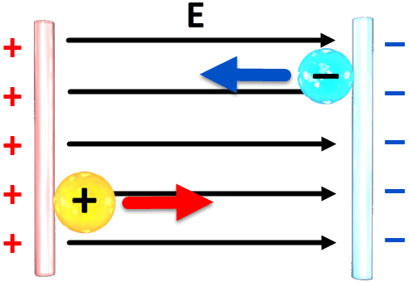
Beta radiation.
β- decay emits negative electrons, so they are deflected in the opposite direction of an electric field. This means they move to the positive plate.
β+ decay emits positive positrons, so they are deflected in the same direction as the direction of the electric field. Therefore, they move to the negative plate.

Slide 16
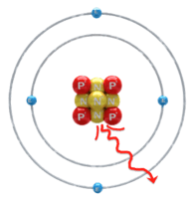
Gamma radiation has no charge, so it is not deflected when it passes through an electric field.
Alpha particles have a greater mass than beta particles, so alpha radiation is deflected less than beta radiation in electric fields. They both experience the same force, but the heavier alpha particle has less acceleration than a light beta particle.

